Slide 1
Monte Carlo Simulations of Lead Time

Slide 2
Business Problem (simplified)
Part 1
Part 2
Part 3
A Kit includes three parts: Part 1, Part 2, Part 3
Every day a certain number of kits is assembled
There are N items of each Part on day 0
A request to order a new batch of three Parts is initiated on day 0
The process consists of three stages:
PR/PO generation
Vendor manufacturing and delivery
Receipt and inspection of Parts
Assumptions
There is variability in the lead times of all stages and the number of kits assembled daily
The lead time distributions are independent
Question: Will we run out of parts before the next delivery?
Kit

Slide 3
Multi-Part Lead Time
Kit
Each part has a lead time with a different mean value
Kit is available when the part with longest lead time is available
Part 1
10 days
Part 2
14 days
Part 3
16 days
Kit Lead Time = MAX(Part1 Lead Time, Part2 Lead Time, Part 3 Lead Time)

Slide 4
Multi-Part Lead Time
Kit
Take into account the spread in the Lead Time
Add the standard deviation
68.2%
Part 1
10 days
Part 2
14 days
Part 3
16 days
Kit Lead Time = MAX(Part1 Lead Time, Part2 Lead Time, Part 3 Lead Time)

Slide 5
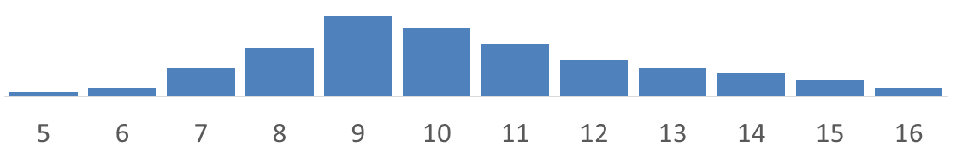
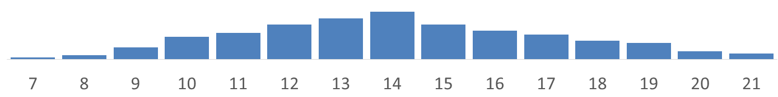
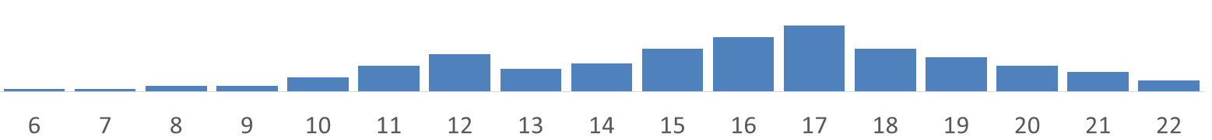
Multi-Part Lead Time
Each Part Lead Time has a probability distribution
Run simulations to create the distribution for the longest lead time
Kit
Part 1
Part 2
Part 3
Kit Lead Time = MAX(Part1 Lead Time, Part2 Lead Time, Part 3 Lead Time)
Maximum of the Individual Times Not Mean Times

Slide 6
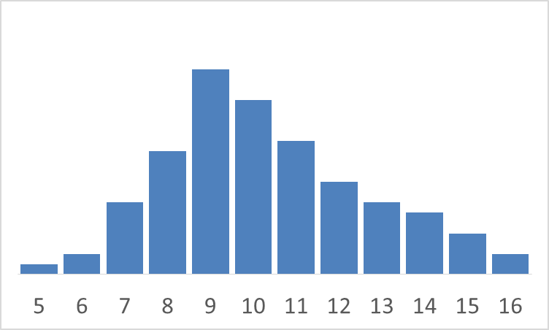
How Monte Carlo Simulations Work
The table shows the number of times each Lead Time value is picked, on average, if we run 100 simulations
A computer program is run to “relive” the same delivery process many times
Every run the program picks a lead time according to the probability; the higher the probability the more likely the lead time is picked
Lead Time | Probability | # times for 100 simulations = Probability * 100
5 | 0.01 | 1
6 | 0.02 | 2
7 | 0.07 | 7
8 | 0.12 | 12
9 | 0.2 | 20
10 | 0.17 | 17
11 | 0.13 | 13
12 | 0.09 | 9
13 | 0.07 | 7
14 | 0.06 | 6
15 | 0.04 | 4
16 | 0.02 | 2

Slide 7
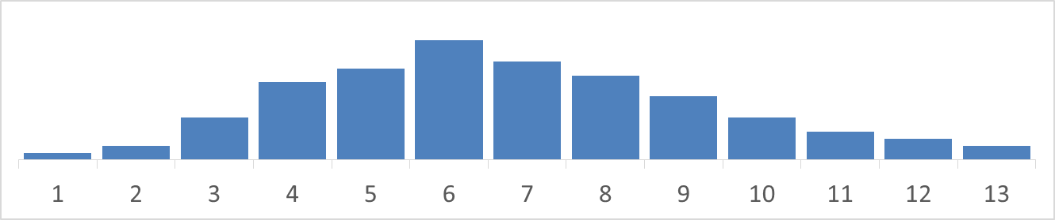
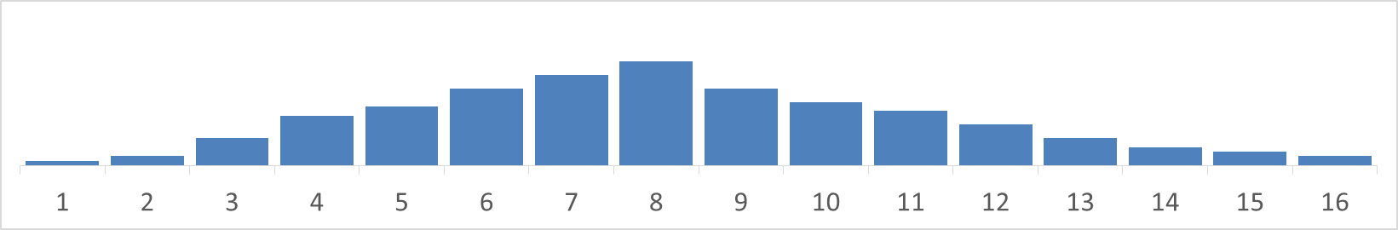
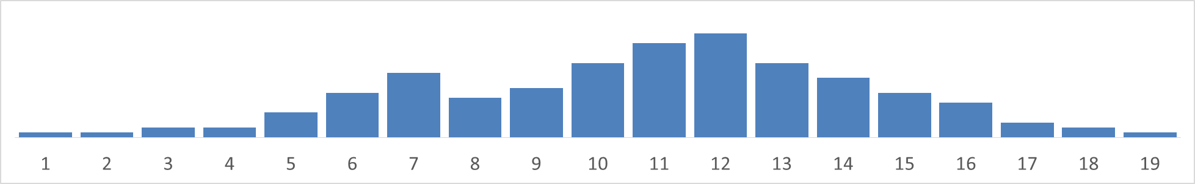
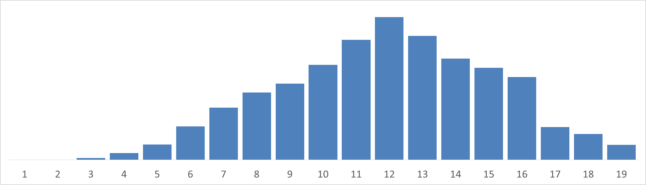
Multi-Part Lead Time – Monte Carlo Simulations
 |  |  | MAX(Part1, Part2, Part3)
6 | 5 | 9 | 9
3 | 7 | 8 | 8
2 | 3 | 5 | 5
7 | 6 | 6 | 7
5 | 11 | 10 | 11
10 | 4 | 10 | 10
5 | 8 | 11 | 11
4 | 12 | 13 | 13
6 | 8 | 7 | 8
9 | 7 | 9 | 9

Slide 8
How Probabilities are Computed
Actual Lead Time | # times for 100 actual deliveris | Probability = # times/100
5 | 1 | 0.01
6 | 2 | 0.02
7 | 7 | 0.07
8 | 12 | 0.12
9 | 20 | 0.2
10 | 17 | 0.17
11 | 13 | 0.13
12 | 9 | 0.09
13 | 7 | 0.07
14 | 6 | 0.06
15 | 4 | 0.04
16 | 2 | 0.02
To compute probabilities work backward (forward, really)
Count the number of times each Lead Time value is present in the historical data
Create a histrogram
See more in Technical Details slide

Slide 9
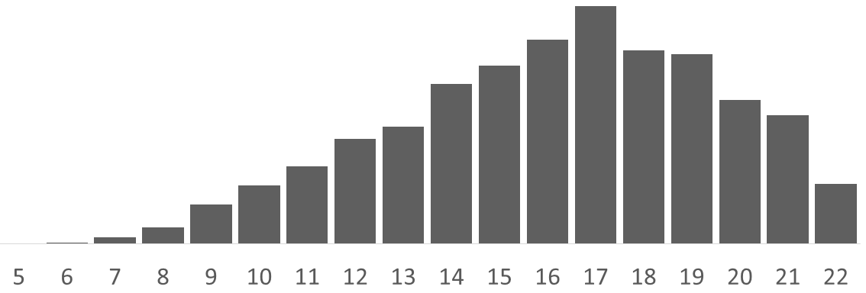
Multi-Part Lead Time
Kit
Combined probability distribution for the complete Kit Lead Time
68.2%
Part 1
Part 2
Part 3

Slide 10
Multi-Step Lead Time
Part 1
Supplier
Lead Time
PR/PO
Lead Time
Receipt
Lead Time
Kit
Generate
PR and PO
Supplier
Manufactures and
Delivers Part X
Receiving and
Inspecting Part X
Part 2
Part 3

Slide 11
Multi-Step Lead Time
Part 1
Part1_Lead_Time = PR/PO_Lead_Time + Supplier_Lead_Time + Receipt_Lead_Time
Sum of the Individual Lead Times Not Mean Times
Mean(Part1_Lead_Time) > Mean(PR/PO_Lead_Time) + Mean(Supplier_Lead_Time) + Mean( Receipt_Lead_Time)
PR/PO
Lead Time
Supplier
Lead Time
Receipt
Lead Time
PR/PO
Lead Time
Supplier
Lead Time
Receipt
Lead Time
PR/PO
Lead Time
Supplier
Lead Time
Receipt
Lead Time

Slide 12
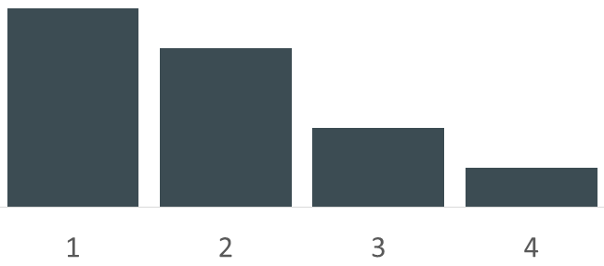
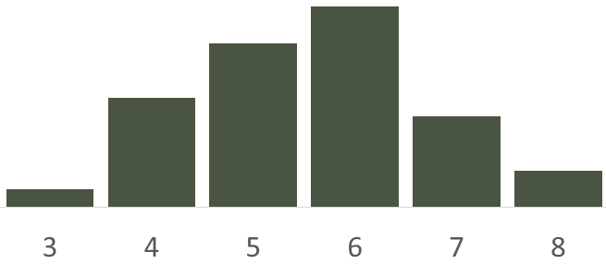
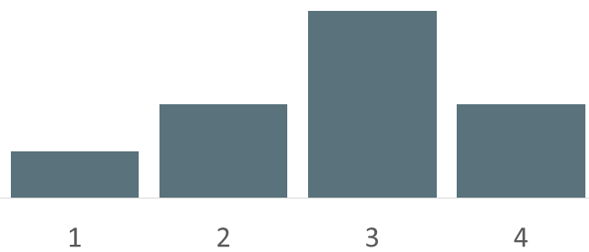
Multi-Step Lead Time
Part1_Lead_Time = PR/PO_Lead_Time + Supplier_Lead_Time + Receipt_Lead_Time
Sum of the Individual Lead Times Not Mean Times
Run Monte Carlo simulations using probability distributions for each Lead Time
PR/PO
Lead Time
Supplier
Lead Time
Receipt
Lead Time

Slide 13

Multi-Step Lead Time - Simulations
PR/PO Lead Time | Supplier Lead Time | Receipt Lead Time | Part 1 Lead Time = PR/PO Lead Time + Supplier Lead Time + Receipt Lead Time
3 | 5 | 1 | 9
3 | 7 | 2 | 12
2 | 3 | 1 | 6
4 | 6 | 3 | 13
4 | 5 | 2 | 11
2 | 4 | 4 | 10
1 | 5 | 1 | 7
4 | 2 | 1 | 7

Slide 14
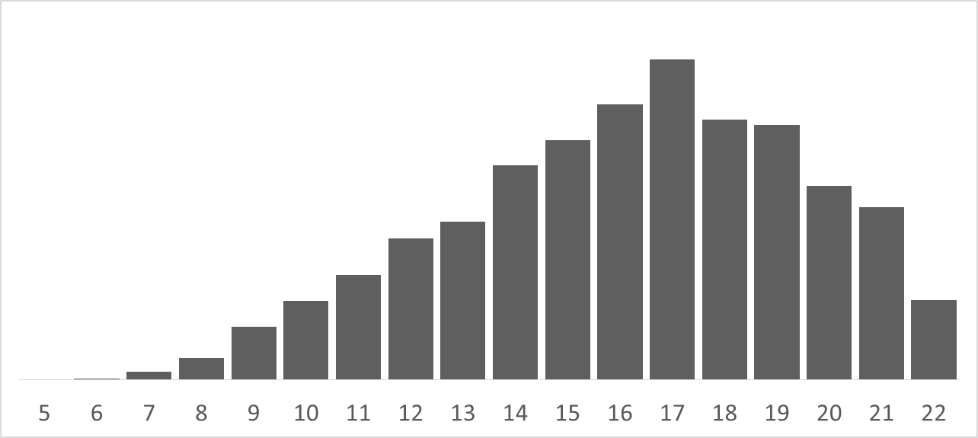
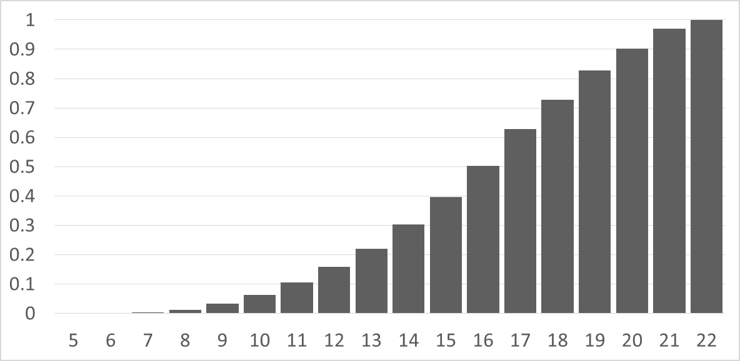
Total Lead Time
PDF – Probability Density Function
CDF – Cumulative Distribution Function
CDF – Cumulative probability value for day X gives the probability all the Parts for the Kit will be delivered by day X
Mean Delivery day is ~16
Median Delivery day is ~16
There is a ~97% probability of delivery by day 21 and 100% probability of delivery by day 22

Slide 15
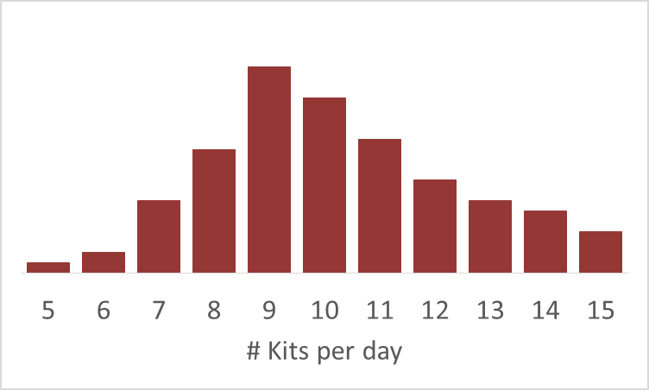
Kit Production
Finally, combine the data of Parts delivery with data on Kits assembly
On average ~10 kits a day
We had parts for N= 200 kits to begin with
On average we run out of parts in 20 days
On average the new delivery will be in 16 days
So we are good!
Are we?
Probability distribution for the number of kits assembled in one day
Run Monte Carlo simulations to compute the probability distribution Pr(X) we run out of parts on day X

Slide 16
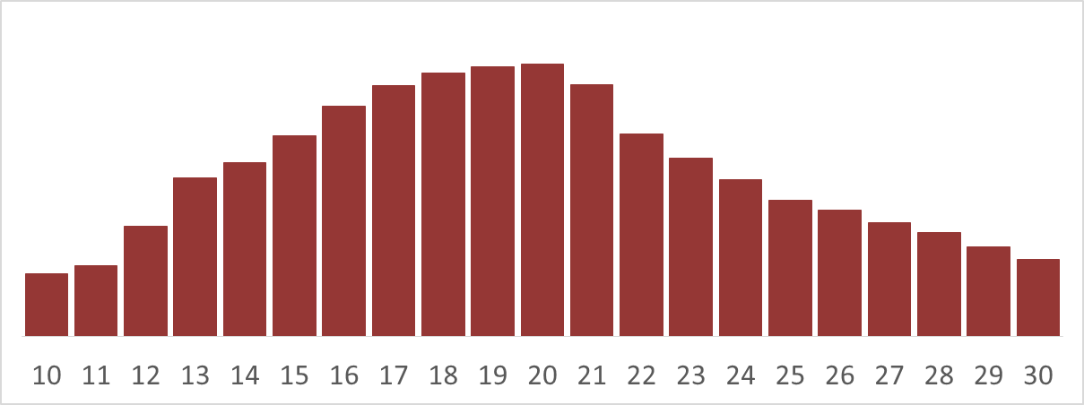
Monte Carlo Simulation to Generate Parts Availability
Run a computer program to simulate Kit assembly
Each day generate number of Kits assembled - the higher the probability the more often that number is used
Continue until run out of parts; record the day #
Repeat
Accumulate the results to create a histogram

Slide 17
Answer
Probability distribution of delivery on day X
Probability we will run out of Parts
Probability distribution of running out of stock on day X

Slide 18
Optimization
Once we have probability distributions for Parts availability we can answer all kinds of questions
What’s the probability of not running out of Parts if we order a day earlier, two days earlier, a week earlier?
Run a “simple” computer simulation simply enumerating all possible values of order generation date.
Find optimal safety stock and the order generation date
Include competing costs to carry out optimization:
Inventory Carrying Cost (ICC), Weighted Average Cost of Capital (WACC), etc.
vs.
Lost productivity, Lost Time, etc.

Slide 19
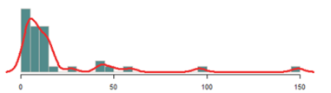
Technical Details
The magic of simulations
In our hypothetical case we have 100 actual deliveries for each part
Based on this data we can generate 100 x 100 x 100 = 1 million simulation runs
Probabilities Computation
1. If there is not enough data to produce a robust probability distribution one can
Aggregate up: find the distribution for a number of similar SKU’s from the same vendor
Fit the data with a parameterized probability distribution curve
2. If individual data is not available, only the mean and standard deviation, one can use a normal or lognormal distribution determined by the mean and standard deviation
3. Have to take care of outliers

